Slide 1

Edge Detection
Lecture 5 -

Slide 2
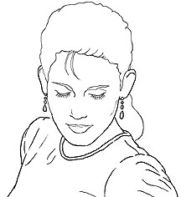
Edge detection
Goal: Identify sudden changes (discontinuities) in an image
Intuitively, most semantic and shape information from the image can be encoded in the edges
More compact than pixels
Source: D. Lowe
Lecture 5 -

Slide 3
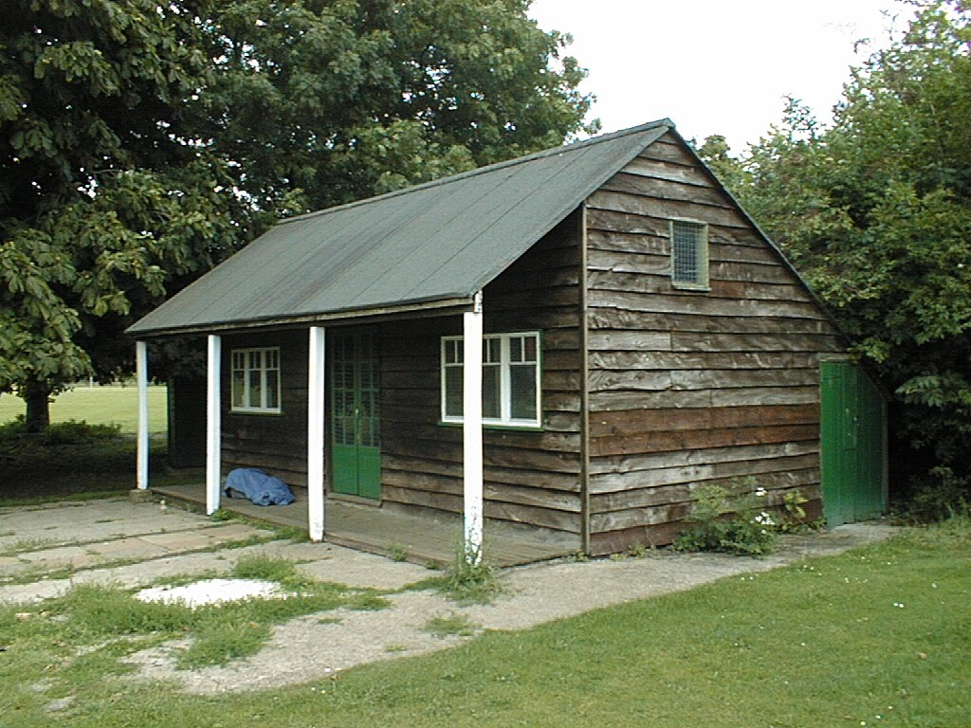
Why do we care about edges?
Extract information, recognize objects
Recover geometry and viewpoint
Vertical vanishing point
(at infinity)
Vanishing line
Vanishing point
Vanishing point
Source: J. Hayes
Lecture 5 -

Slide 4
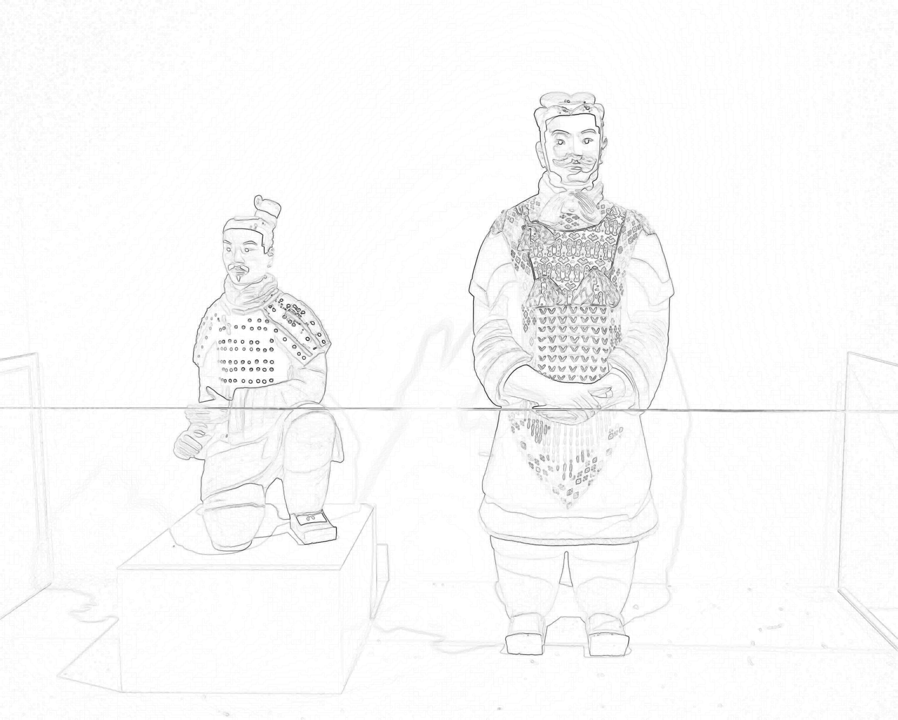

Origin of Edges
What is causing edges in an image?
Discontinuity
Surface normal
Surface color
Illumination
Depth
Material
etc.
Notes:
What is normal? Normalized cross product
What is color? Spectrum reflected or emitted by materials’ structure and received by eyes
Illumination? Strength of photo flux
Depth? Relative distance to the point of view
Material? Refractive index
Frame? Sensor size
Physics correspondence. Understand the physical world.

Slide 5
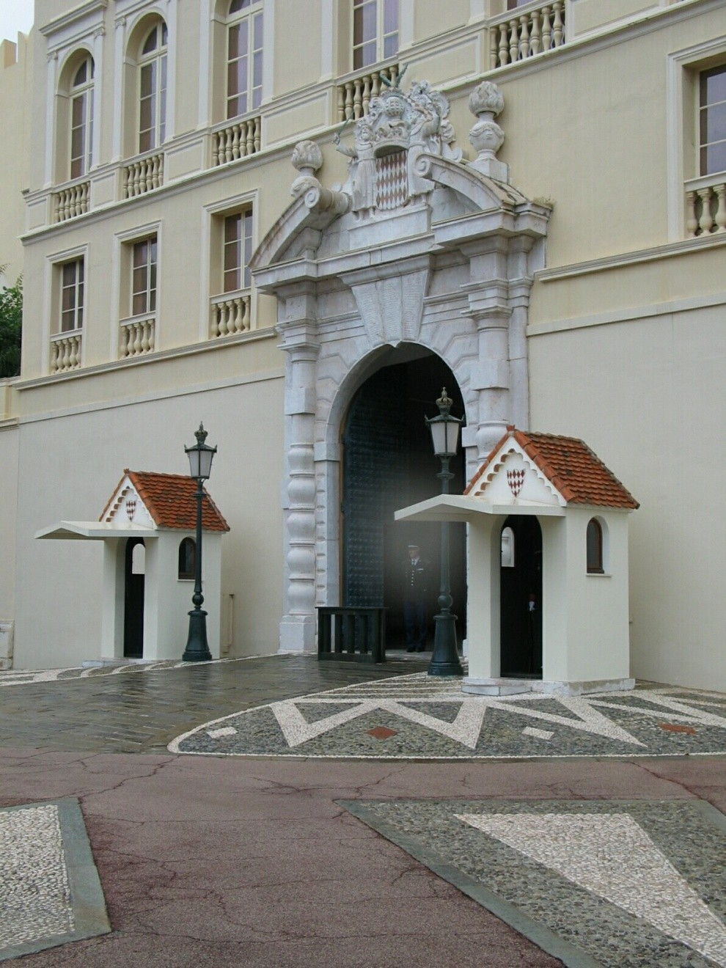
Origins of edges
surface normal discontinuity
depth discontinuity surface color discontinuity illumination discontinuity
Source: D. Hoiem
Lecture 5 -

Slide 6



Closeup of edges
Surface normal discontinuity
Source: D. Hoiem
Lecture 5 -

Slide 7



Closeup of edges
Depth discontinuity
Source: D. Hoiem
Lecture 5 -

Slide 8
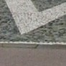
Closeup of edges
Surface color discontinuity
Source: D. Hoiem
Lecture 5 -

Slide 9

Characterizing edges
An edge is a place of rapid change in the image intensity function
intensity function
image (along horizontal scanline) first derivative
edges correspond to extrema of derivative
Lecture 5 -

Slide 10
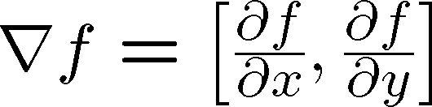

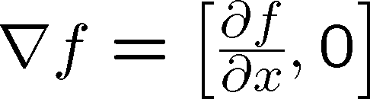


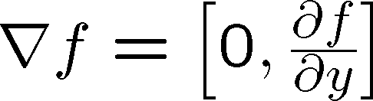
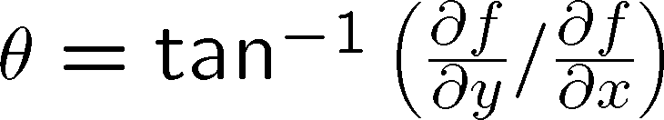
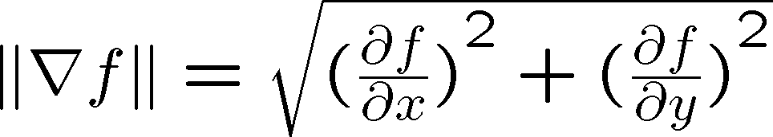
Image gradient
The gradient of an image:
The gradient points in the direction of most rapid increase in intensity
The gradient direction is given by
how does this relate to the direction of the edge?
The edge strength is given by the gradient magnitude
Source: Steve Seitz
Lecture 5 -

Slide 11
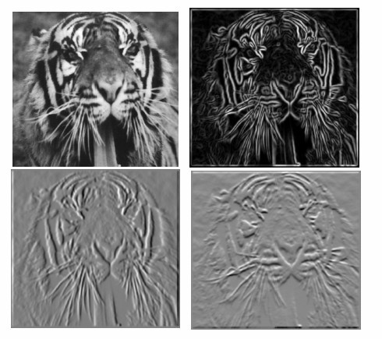
Finite diﬀerences: example
Which one is the gradient in the x-­‐ direction?
How about y-­‐ direction?
Lecture 5 -

Slide 12
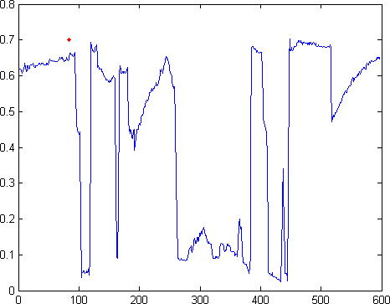
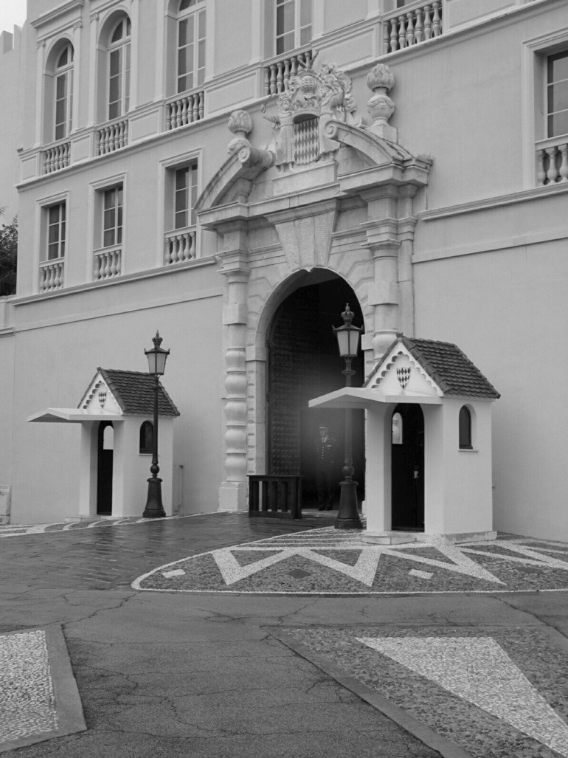
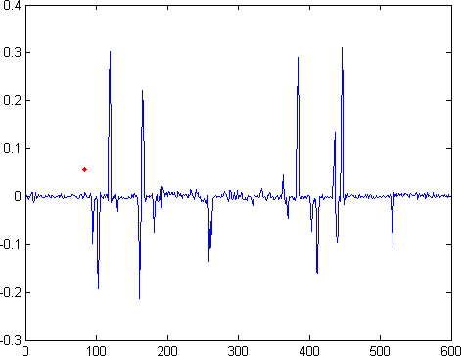
Intensity proﬁle
Intensity
Gradient
Source: D. Hoiem
Lecture 5 -

Slide 13
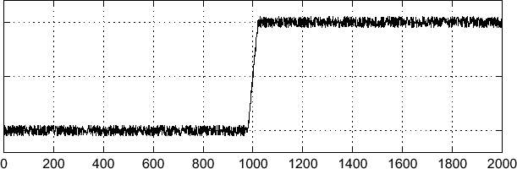
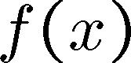
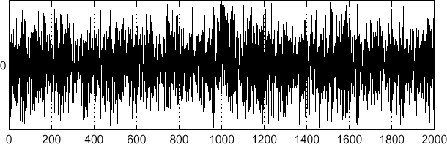
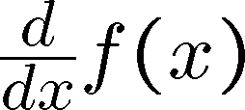
Eﬀects of noise
Consider a single row or column of the image
– Plotting intensity as a function of position gives a signal
Where is the edge?
Source: S. Seitz
Lecture 5 -

Slide 14
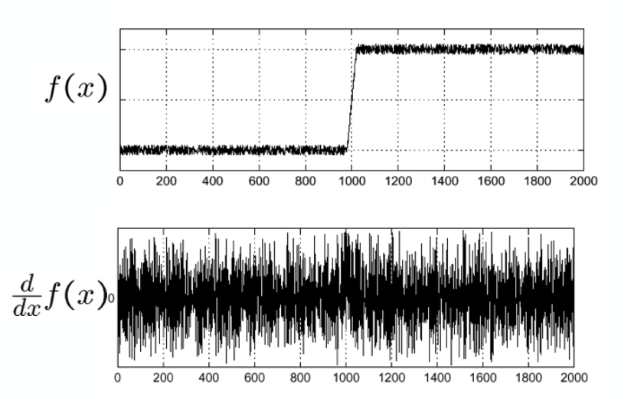
Noise
Effects on gradient calculation?
Where does noise come from?
- Shot noise -> Photon fluctuation
- Dark noise -> Electron fluctuation
- Read noise -> Reading error
- Irrelevant details
Noise comes from reality and cause distraction.
Computer vision is to find meaningful elements through abstraction.
How to remove noise?

Slide 15
Eﬀects of noise
Finite diﬀerence ﬁlters respond strongly to noise
Image noise results in pixels that look very diﬀerent from their neighbors
Generally, the larger the noise the stronger the response
What is to be done?
Source: D. Forsyth
Lecture 5 -

Slide 16
Eﬀects of noise
Finite diﬀerence ﬁlters respond strongly to noise
Image noise results in pixels that look very diﬀerent from their neighbors
Generally, the larger the noise the stronger the response
What is to be done?
Smoothing the image should help, by forcing pixels diﬀerent to their neighbors (=noise pixels?) to look more like neighbors
Source: D. Forsyth
Lecture 5 -

Slide 17
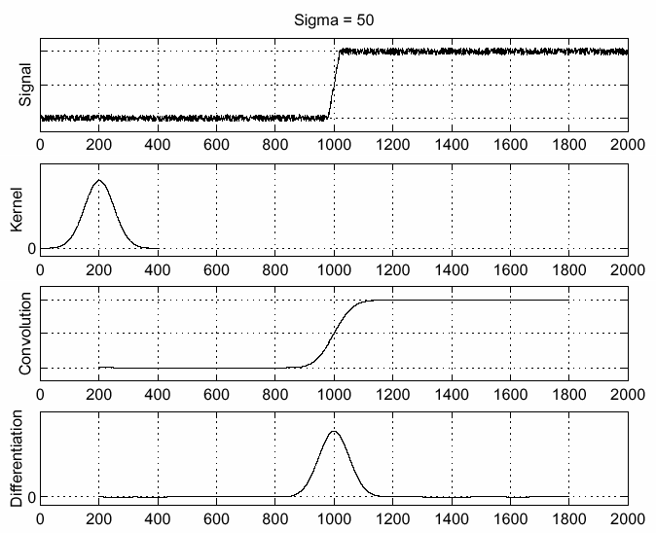
Solution: smooth ﬁrst
f
g f * g
^{d} ( f ∗ g)
dx
To ﬁnd edges, look for peaks in
^{d} ( f ∗ g )
dx
Source: S. Seitz
Lecture 5 -

Slide 18
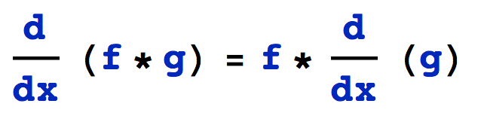
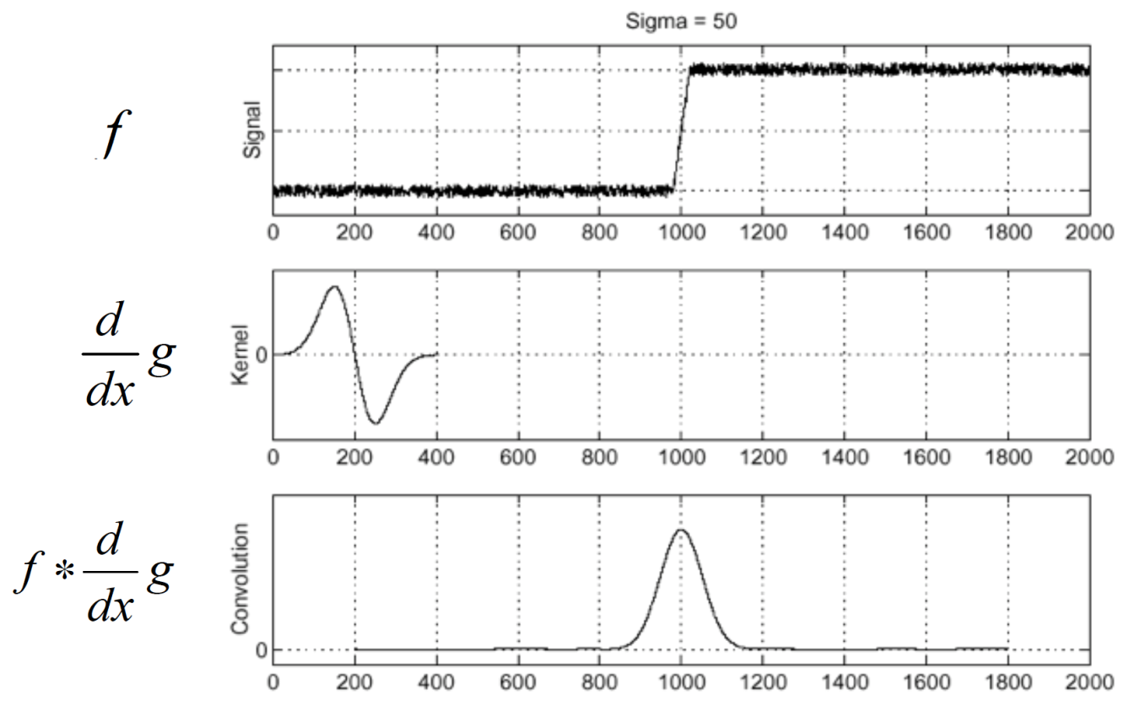
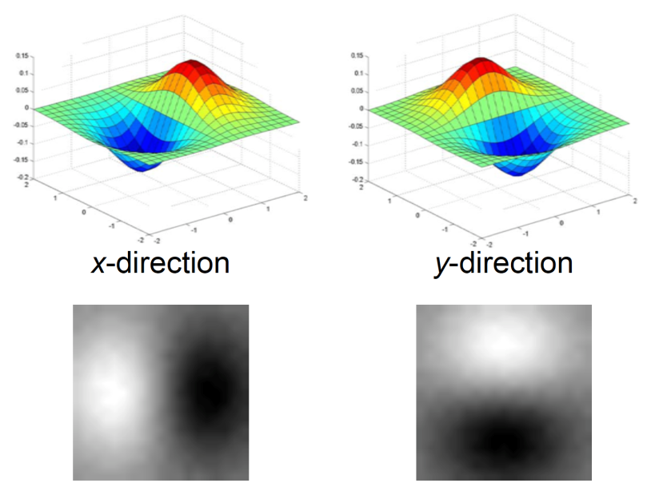
Derivative of Gaussian
Differentiation is convolution
Convolution is associative
Laplacian of Gaussian: Pre-calculated to reduce operations
Log

Slide 19
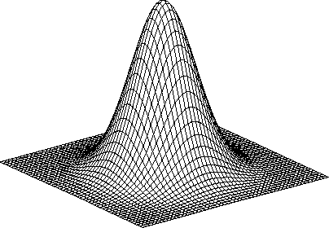
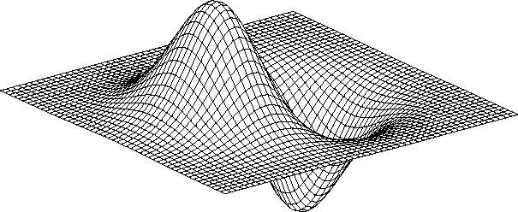
Derivative of Gaussian ﬁlter
* [1 -1] =
Is this ﬁlter separable?
Lecture 5 -

Slide 20
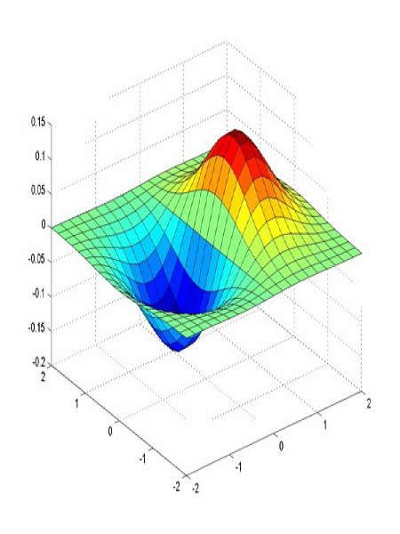
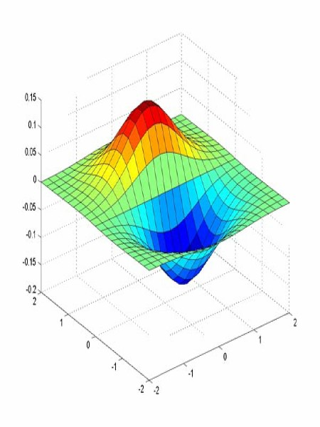
Derivative of Gaussian ﬁlter
x-direction
y-direction
Lecture 5 -

Slide 21
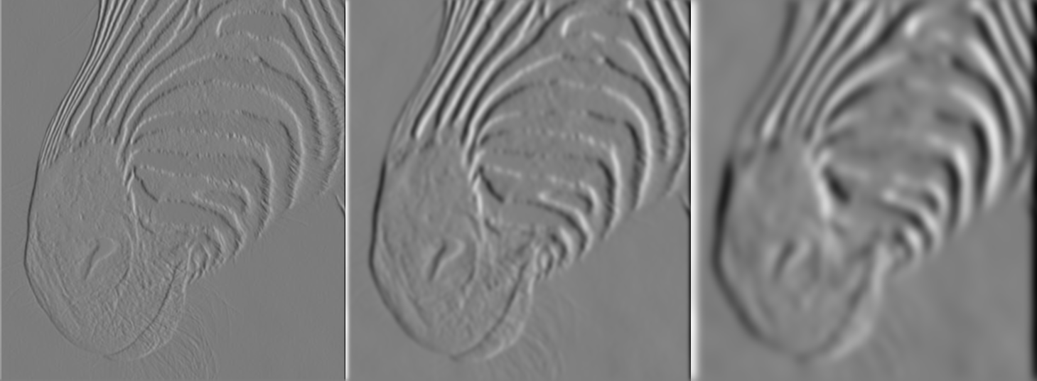
Tradeoﬀ between smoothing and localization
1 pixel 3 pixels 7 pixels
Smoothed derivative removes noise, but blurs edge. Also ﬁnds edges at diﬀerent “scales”.
Source: D. Forsyth
Lecture 5 -

Slide 22
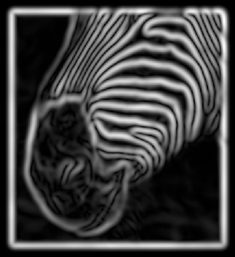
Implementation issues
The gradient magnitude is large along a thick “trail” or “ridge,” so how do we identify the actual edge points?
How do we link the edge points to form curves?
Source: D. Forsyth
Lecture 5 -

Slide 23
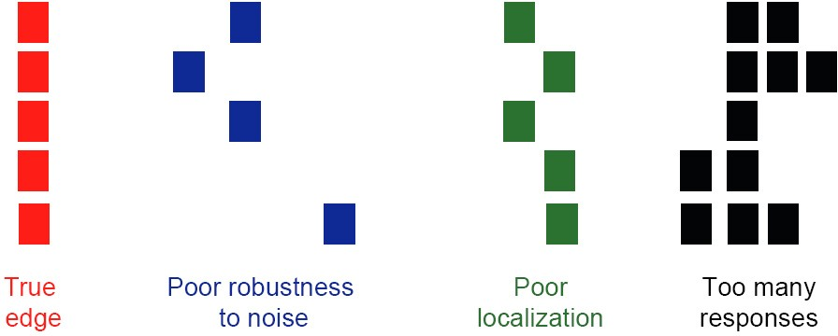
Designing an edge detector
Criteria for an “optimal” edge detector:
Good detection: the optimal detector must minimize the probability of false positives (detecting spurious edges caused by noise), as well as that of false negatives (missing real edges)
Good localization: the edges detected must be as close as possible to the true edges
Single response: the detector must return one point only for each true edge point; that is, minimize the number of local maxima around the true edge
Lecture 5 -

Slide 24
Canny edge detector
This is probably the most widely used edge detector in computer vision
Canny Edge Detection is a popular edge detection algorithm.
It was developed by John F. Canny in 1986.
It is a multi-stage algorithm
Canny has shown that the ﬁrst derivative of the Gaussian closely approximates the operator that optimizes the product of signal-to-noise ratio and localization
Lecture 5 -

Slide 25

Example
original image (Lena)
Lecture 5 -

Slide 26
1.Noise Reduction
Since edge detection is susceptible to noise in the image, first step is to remove the noise in the image with a 5x5 Gaussian filter.

Slide 30
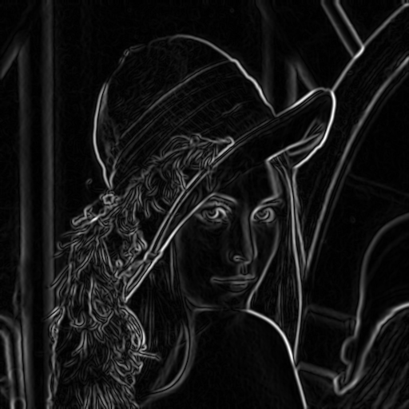
Before Non-max Suppression
Source: J. Hayes
Lecture 5 -

Slide 31
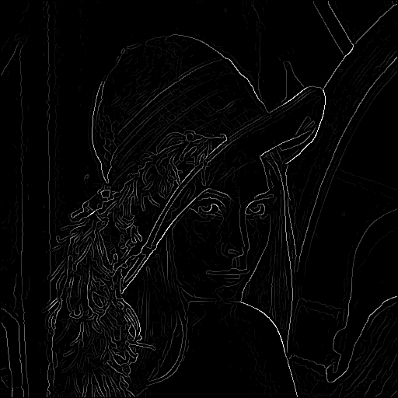
After non-max suppression
Source: J. Hayes
Lecture 5 -

Slide 34
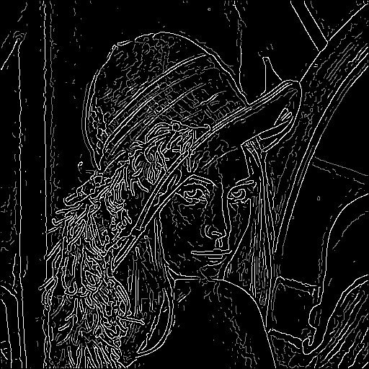
Hysteresis thresholding
Threshold at low/high levels to get weak/strong edge pixels
Do connected components, starting from strong edge pixels

Slide 35
Hysteresis thresholding
Check that maximum value of gradient value is suﬃciently large
drop-outs? use hysteresis
use a high threshold to start edge curves and a low threshold to continue them.
Source: S. Seitz
Lecture 5 -

Slide 36
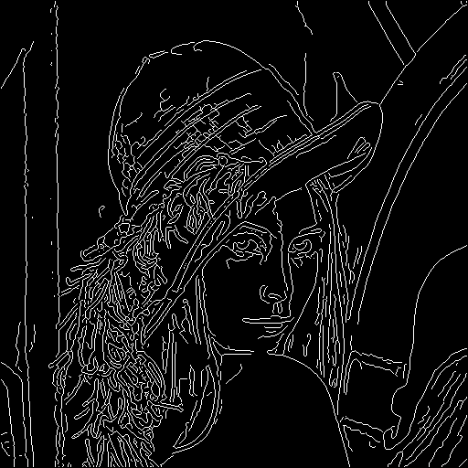
Final Canny Edges
Lecture 5 -

Slide 37
Canny edge detector
Filter image with x, y derivatives of Gaussian
Find magnitude and orientation of gradient
Non-maximum suppression:
Thin multi-pixel wide “ridges” down to single pixel width
Thresholding and linking (hysteresis):
Deﬁne two thresholds: low and high
Use the high threshold to start edge curves and the low threshold to continue them
Lecture 5 -

Slide 38

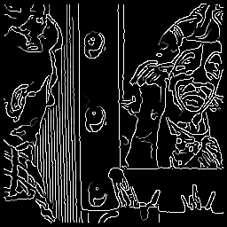
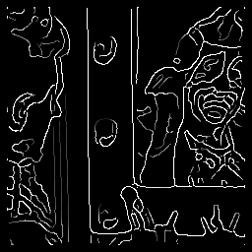
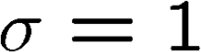

Eﬀect of σ (Gaussian kernel spread/size)
original Canny with Canny with
The choice of σ depends on desired behavior
large σ detects large scale edges
small σ detects ﬁne features
Source: S. Seitz
Lecture 5 -

Slide 39
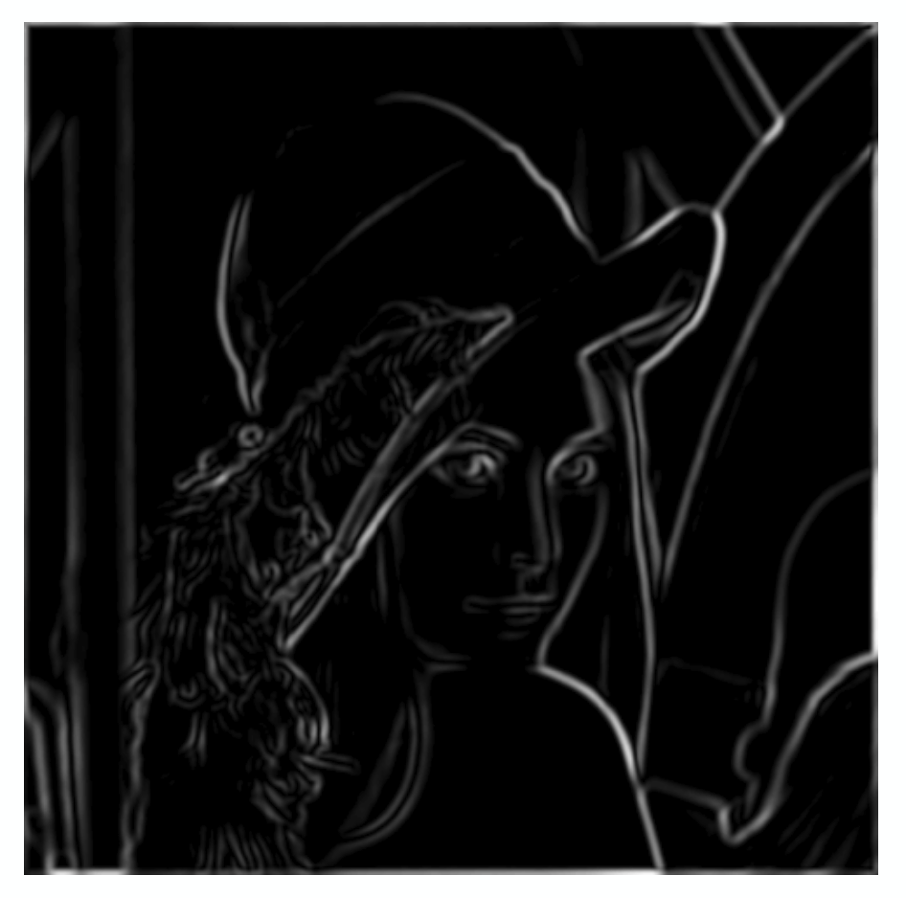
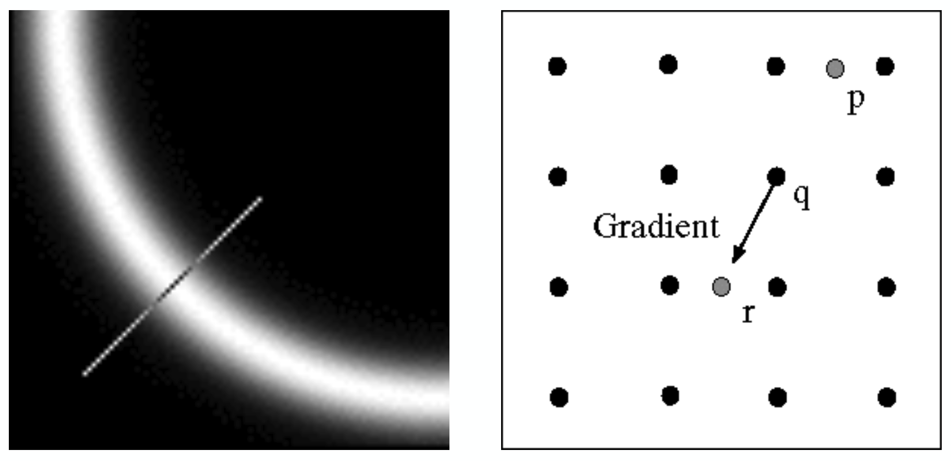
Non-maximum Suppression
Check if pixel is local maximum along gradient direction.
Select single max across width of the edge.

Slide 40
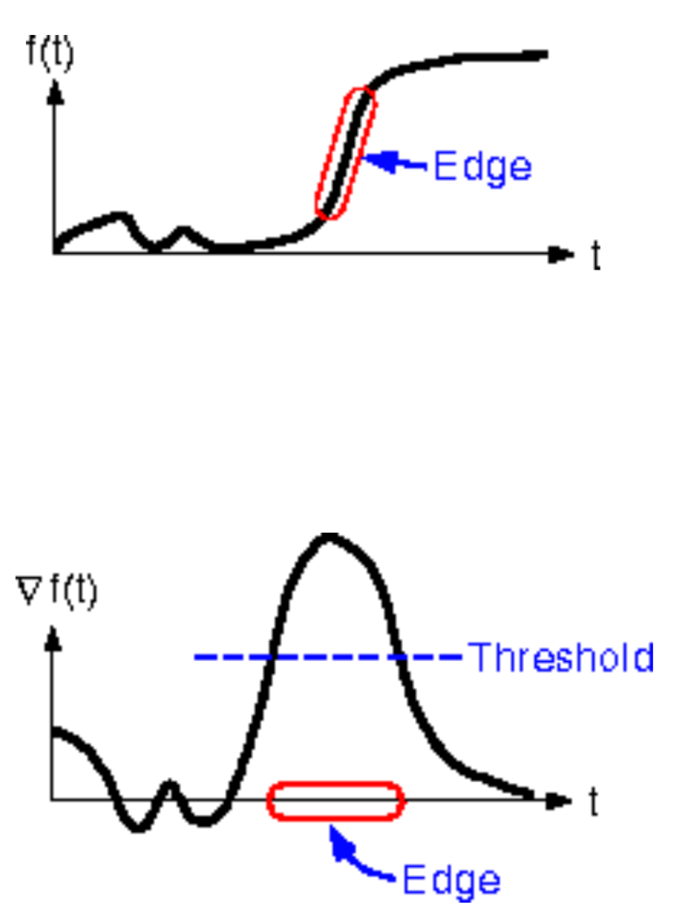
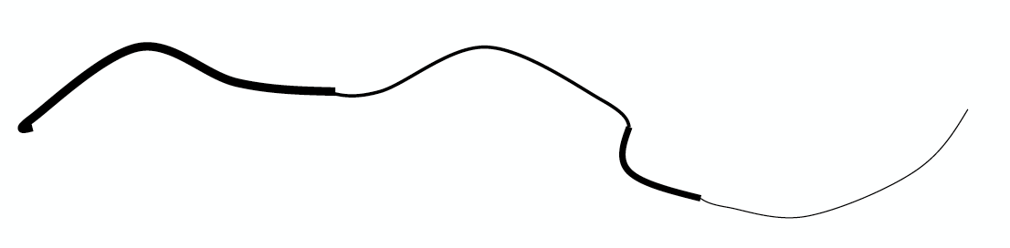
Linking and Thresholding
Use a high threshold to start edge curves, and a
low threshold to continue them.

Slide 41
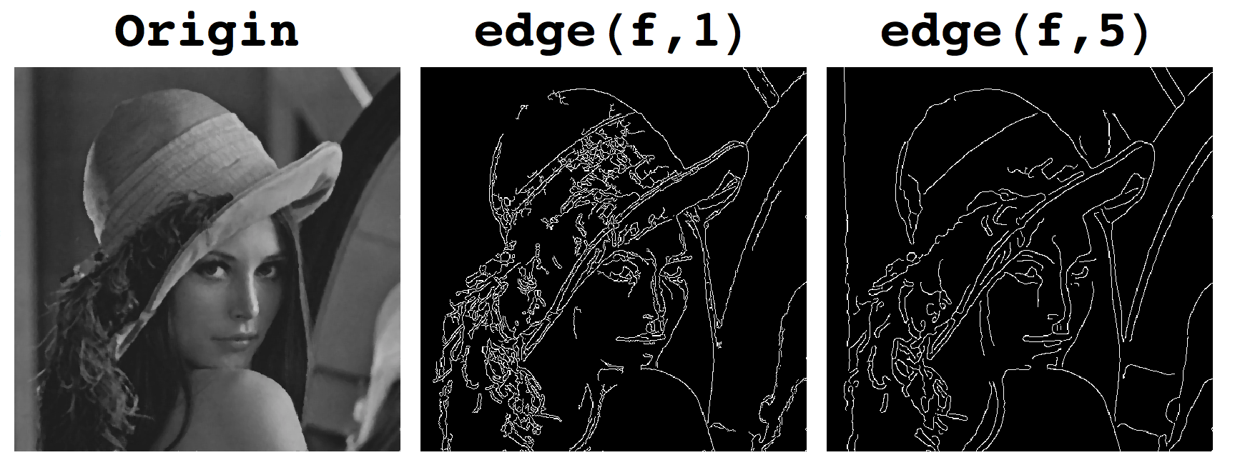
Canny Edge Detection
Filter image with derivative of Gaussian (LoG)
Find magnitude and orientation of gradient
Non-maximum suppression:
- Thin wide “ridges” down to single pixel width
Linking and thresholding (hysteresis):
- Define two thresholds: low and high
- Use the high threshold to start edge curves and the
low threshold to continue them

Slide 42
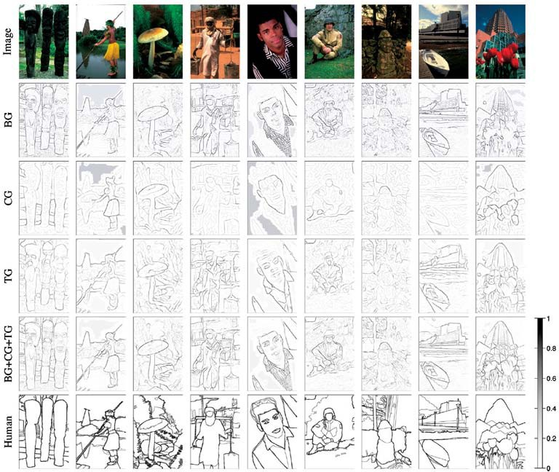
Gradients (e.g. Canny)
Color
Texture
Combined
Human
Lecture 5 -

Slide 43
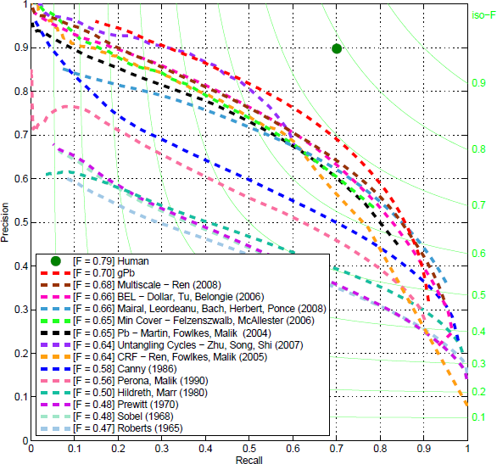
45 years of boundary detection
Source: Arbelaez, Maire, Fowlkes, and Malik. TPAMI 2011 (pdf)
Lecture 5 -

